Slide 1
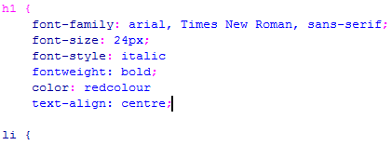
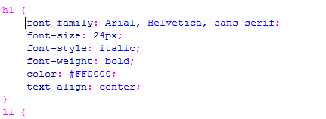
Web Authoring
Task 2 – Correcting CSS (Part 1: Stylesheet1)
Stylesheet1
Font: Arial, Helvetica or default sans-serif font
Font Size: 24px
Italic, Bold, Red and center aligned.
Incorrect CSS
Remove to see the correct answer
>>>>>>>>
Task 1
Identify and place the red boxes over the mistakes in the CSS.
Open stylesheet1 and make the corrections.
Correct CSS

Slide 2
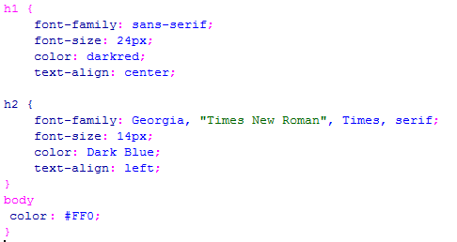
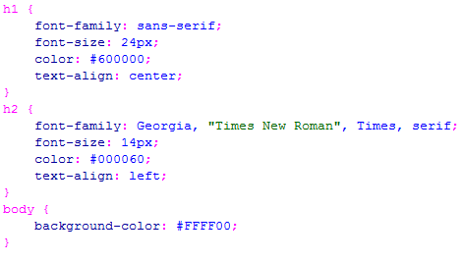
Web Authoring
Task 2 – Correcting CSS (Part 2: Stylesheet2)
Stylesheet2
Colour Attributes:
H1 – B 00 G 00 R 60
H2 – G 00 R 00 B 60
Body – B 00 R FF G FF
Incorrect CSS
Remove to see the correct answer
>>>>>>>>
Task 2
Identify and place the red boxes over the mistakes in the CSS.
Open stylesheet2 and make the corrections.
Correct CSS

Slide 3
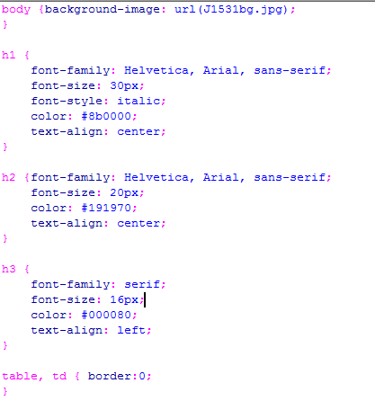
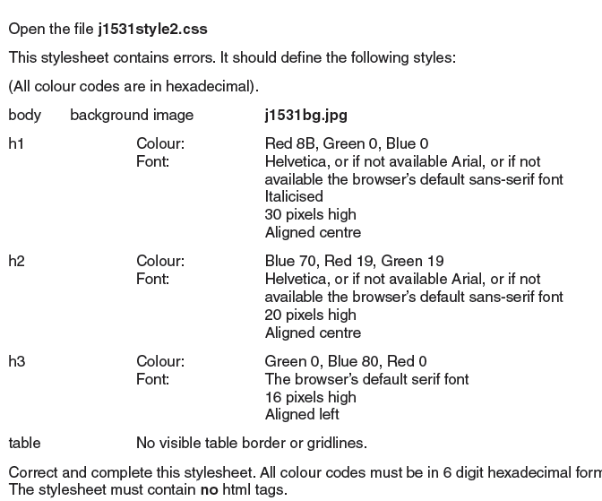
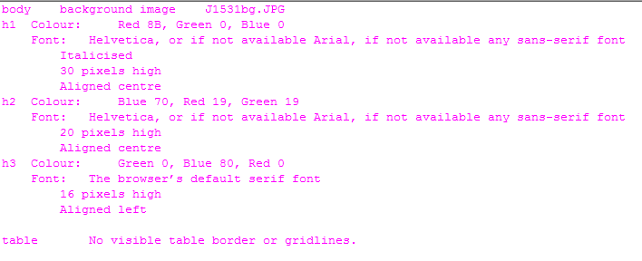
Web Authoring
Task 3 – Correcting CSS
Correcting CSS for Text Styles
#8B0000
#191970
If you are editing the CSS then put the brackets {Start & End } in the correct place for each tag.
Then use the CSS window to enter correct CSS and delete the old (useless) code.
#000080
Mistakes:
No brackets to open and close CSS Tags
No semi-colons to separate parts of the CSS
Colours in wrong order
Spelling mistakes
Unnecessary Text

